Slide 1
Implement a Distributed Data Analytics Tool on AWS
Group 7
Chenyun Yang, Yuan Meng, Zongzhu Li
Github:https://github.com/AaronYcY/CloudComputing

Slide 2
Why(background)
Data analysis is important.
Normal analyzing tools that works on the local machine may need a lot of computing resource. Some analyzing work taking lots of resources may slow down other works.
As we know that AWS provides a convenient way for people to order the resource they want. It is a great way to help people accurate the workflow.
Using workflow provide a more stable working experience than local machine.

Slide 3
Project Overview
Providing a stable and scalable data analyzing framework which is suitable for AWS to deploy.
Providing functional actors defined by actor model which is deployed on AWS. (Actors are easy to build)

Slide 4
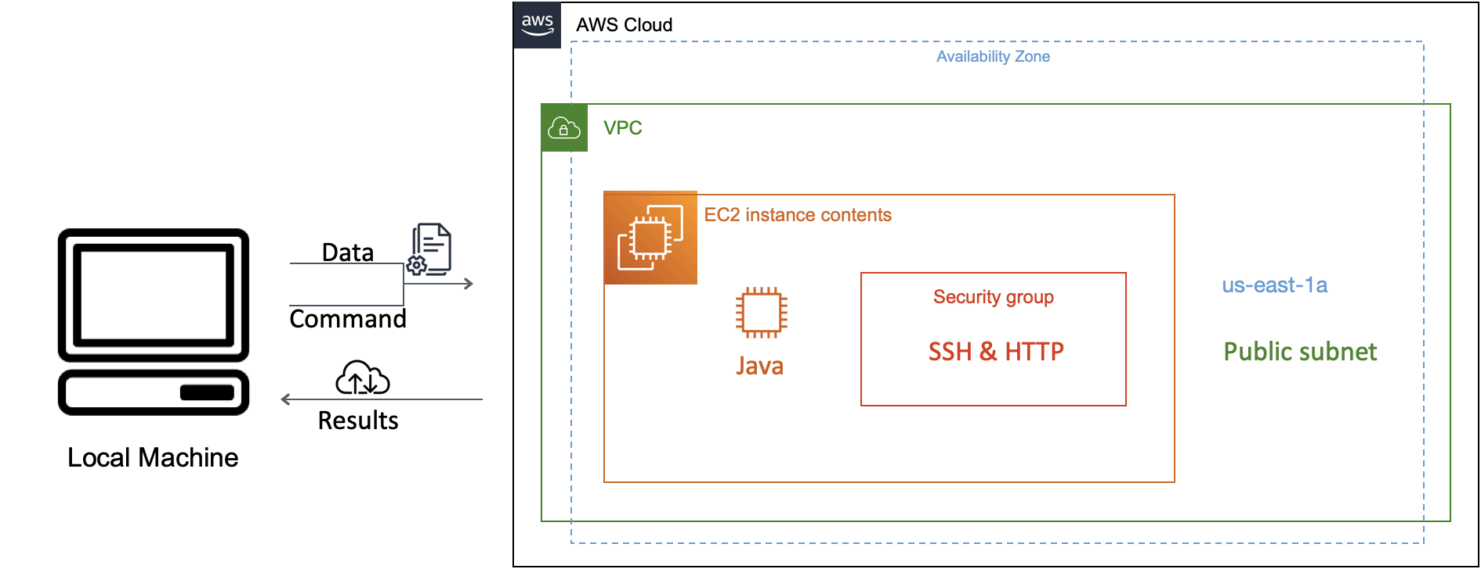
Overall Workflow

Slide 5
Workflow On AWS
EC2 Unit
Data
Resource
Initialization Function
Actor1
Actor2
Output
Function
(Result)
Loading
Receiving
Function
Actor3
Actor4

Slide 6
DEMO
https://github.com/AaronYcY/CloudComputing/blob/main/Recording-1.mp4

Slide 7
What Can Be Improved In The Future
Create a more user friendly interface
Create scalability modules to improve computing efficiency
Implement more modules with other functions like machine learning, NLP

Slide 8
References
1. COVID-19 Data, The New York TIMES https://github.com/nytimes/covid-19-data
2. A Demonstration of TextDB: Declarative and Scalable Text Analytics on Large Data Sets, Zuozhi Wang, Flavio Bayer, Seungjin Lee, Kishore Narendran, Xuxi Pan, Qing Tang, Jimmy Wang, Chen Li, ICDE 2017, Best Demo award, https://chenli.ics.uci.edu/files/icde2017-textdb-demo.pdf
3.AKKA.
https://developer.lightbend.com/docs/akka-platform-guide/deployment/aws-index.html
4. AWS EC2.
https://docs.aws.amazon.com/AWSEC2/latest/WindowsGuide/concepts.html
Thank you

